Slide 1
Welcome to:
Transforming lives by the power of God’s
Spirit, love, grace, and truth.

Slide 2
Our mission statement:
Transforming lives by the power of God’s Spirit, love, grace, and truth.

Slide 3
Matthew 28:18 And Jesus came and said to them, “All authority in heaven and on earth has been given to me. 19 Go therefore and make disciples of all nations, baptizing them in the name of the Father and of the Son and of the Holy Spirit, 20 teaching them to observe all that I have commanded you. And behold, I am with you always, to the end of the age.” (ESV, emphasis mine)

Slide 4
Romans 12:1 I appeal to you therefore, brothers, by the mercies of God, to present your bodies as a living sacrifice, holy and acceptable to God, which is your spiritual worship. 2 Do not be conformed to this world, but be transformed by the renewal of your mind, that by testing you may discern what is the will of God, what is good and acceptable and perfect. (ESV)

Slide 5
1. The plan God has for his people is transformation.

Slide 6
Colossians 1:28 Him we proclaim, warning everyone and teaching everyone with all wisdom, that we may present everyone mature in Christ. 29 For this I toil, struggling with all his energy that he powerfully works within me. (ESV)

Slide 7
2. Transformation is a process. God causes the growth, and he uses relationships.

Slide 8
1 Corinthians 3:1 But I, brothers, could not address you as spiritual people, but as people of the flesh, as infants in Christ. 2 I fed you with milk, not solid food, for you were not ready for it. And even now you are not yet ready, 3 for you are still of the flesh. For while there is jealousy and strife among you, are you not of the flesh and behaving only in a human way? 4 For when one says, “I follow Paul,” and another, “I follow Apollos,” are you not being merely human? (ESV, emphasis mine)

Slide 9
1 Corinthians 3:5 What then is Apollos? What is Paul? Servants through whom you believed, as the Lord assigned to each. 6 I planted, Apollos watered, but God gave the growth. 7 So neither he who plants nor he who waters is anything, but only God who gives the growth. 8 He who plants and he who waters are one, and each will receive his wages according to his labor. 9 For we are God's fellow workers. You are God's field, God's building. (ESV)

Slide 10
1 Corinthians 3:10 According to the grace of God given to me, like a skilled master builder I laid a foundation, and someone else is building upon it. Let each one take care how he builds upon it. (ESV)

Slide 11
3. The plan God has for our transformation also leads to ministry and multiplication to more and more people.

Slide 12
Mark 3:14 And he appointed twelve (whom he also named apostles) so that they might be with him and he might send them out to preach (ESV)

Slide 13
2 Timothy 2:1 You then, my child, be strengthened by the grace that is in Christ Jesus, 2 and what you have heard from me in the presence of many witnesses entrust to faithful men who will be able to teach others also. (ESV)

Slide 14
Paul
Timothy
Faithful Men
Others Others Others Others

Slide 15
Ephesians 4:11 And he gave the apostles, the prophets, the evangelists, the shepherds and teachers, 12 to equip the saints for the work of ministry, for building up the body of Christ, 13 until unity of the faith and of the knowledge we all attain to the of the Son of God, to mature manhood, to the measure of the stature of the fullness of Christ, (ESV, emphasis mine)

Slide 16
How are we to pursue this mission?

Slide 17
Research Reported in Simple Church (Gagne & Rainer)
Churches with a simple process for reaching and maturing people are expanding the kingdom. (p. 14)
Church leaders who have designed a simple biblical process to make disciples are effectively advancing the movement of the gospel. (p. 14)
Vibrant and growing churches had a clear process for discipleship – they were streamlined and simple. (p. 63)
Struggling churches had no clear process (p. 63)
“There is a highly significant relationship between a simple church design and the growth and vitality of a local church.” (p. 67)

Slide 18
Paradigm shifts needed in the church today: (from The Trellis and The Vine):
From running programs to building people
From running events to training people
From filling gaps to training new workers
From solving problems to helping people make progress
From clinging to ordained ministry to developing team leadership
From engaging in management to engaging in ministry
From seeking church growth to desiring gospel growth

Slide 19
What is our process?

Slide 20
Watershed

Slide 21
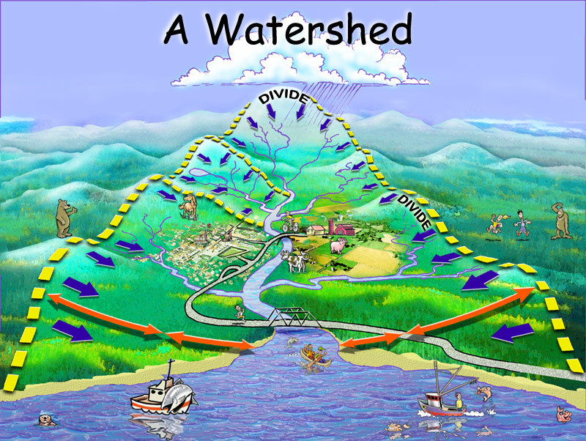
“A region of land within which water flows down into a specified body, such as a river, lake, sea, or ocean; a drainage basin.” (Watershed in wiktionary online dictionary http://en.wiktionary.org/wiki/watershed downloaded on 4.9.10)

Slide 22
Watershed
“A critical point marking a change in course or development.”
“a watershed moment” in life
Something transformational!!!
Watershed in wiktionary online dictionary http://en.wiktionary.org/wiki/watershed downloaded on 4.9.10

Slide 23
Where should we begin?

Slide 24
What does a person need at the beginning of the transformation process?

Slide 25
Devotion
Stage I:

Slide 26
Primary Topics/Questions:
Who is God?
Who am I?
What is my purpose?
What does it mean to have a relationship with God?
Why Church?

Slide 27
Description at the Devotion Stage:
The person has a basic essential knowledge of God and humankind, understands the Gospel, and has made a profession of faith in Jesus Christ. The person is practicing repentance from sin, is beginning to grow spiritually, and is beginning to walk with God. The person has learned the importance of worship, studying the Bible, praying, connecting with other Christians, and is attending church. The person has either been baptized or is interested in getting baptized in the near future.

Slide 28
Primary Resources:
Streams of Water (40 Days of Devotions)
Knowing God
Growing Spiritually

Slide 29
Participation in the Process:
Believe the gospel, turn to and trust Christ
Learn about and get baptized
Begin to develop relationships in the church through worship service attendance, church social events, house groups, and other ministries
Do Streams of Water (40 Days of Devotions)
Do the Knowing God and Growing Spiritually studies
Walk with God and practice spiritual disciplines

Slide 30
Connection
Stage II:

Slide 31
Primary Topics/Questions:
How can I get connected with others?
How can I have healthy relationships?
How can I heal from past hurts in relationships?
Why Church membership?

Slide 32
Description at the Connection Stage:
The person is building healthy relationships with other Christians for mutual growth and encouragement. Evidence of this can be seen through regular participation in church and life events with other believers such as church attendance, social events, house group, and becoming a member. The person is receiving and is in the process of experiencing the necessary help and healing from God to overcome present and past hurts, relational and emotional problems, and sin struggles.

Slide 33
Primary Resources:
Understanding People
Healthy Relationships

Slide 34
Participation in the Process:
Continue to develop relationships in the church
Get more involved in the life of the church (consistently attend the worship service, join a house group, participate in social events and ministries, etc.)
Attend a New Members’ Luncheon and Class
Become a Church member
Do the Understanding People study
Do the Healthy Relationships study

Slide 35
Equipping
Stage III:

Slide 36
Primary Topics/Questions:
How do I help peoples’ lives be transformed?
How do I serve God and others?
What can I do to contribute?
How do I deal with opposition?

Slide 37
Description at the Equipping Stage:
The person has a growing relationship with God that is leading to an increasing motivation to help other peoples’ lives be transformed. The person is learning and developing skills to effectively minister to others and is prepared for the possibility of opposition. The person can share his/her testimony, can share the gospel, and knows how to help someone else grow and mature in their relationship with God. The person is discovering his/her gift areas and is developing a sense of calling and purpose for how God might use him/her in ministering to others.

Slide 38
Primary Resources:
Disciple Building: a Biblical Framework
Evangelism Training Manual
Spiritual Warfare Manual
Various – as needed for specific ministry area(s) of interest

Slide 39
Participation in the Process:
Learn about and get involved in a specific area of ministry interest or need in the church
Read Disciple Building a Biblical Framework and begin to mentor/disciple someone
Do the Evangelism Training study and
Learn how and begin to share your testimony
Learn how and begin to share your faith
Do the Spiritual Warfare study

Slide 40
Sending
Stage IV:

Slide 41
Primary Topics/Questions:
How/In what ways does God want to use me?
Where does God want to use me?

Slide 42
Description at the Sending Stage:
The person knows his/her gift areas and has a sense of calling and purpose for how God might use him/her. The person is actively involved in doing ministry in some way and is building up others in the body of Christ through the ministry he/she is doing. The person has grown in leadership, ministry skills, and in training others and may be leading in a specific ministry area or areas.

Slide 43
Primary Resources:
Various – specific to the individual and specific ministry area(s)

Slide 44
Participation in the Process:
Be actively and consistently involved in a specific area of ministry interest, calling, or need in the church.
Be involved in transforming other peoples’ lives and developing others through relationships, teaching and training, and leadership.
Be open and willing as God leads to a leadership role in a specific ministry area of interest, calling, or need.
Be open and willing to respond to God’s leading to minister to new people and/or places.

Slide 45
Watershed
Transforming lives by the power of God’s Spirit,
love, grace, and truth.

Slide 46
How do you get started?
Start with where you are and what you need
Consider where others are and what they need (and how you might come alongside and help)
Do these things in community with others
Join a house group
Ask 1-2 other people to go through the process with you
Sunday services, socials, and ministry events are a big part of the process
Order or borrow resources

Slide 47
Prayer

